Slide 1

POLICE DEPARTMENT CHATBOT FOR FIR COMPLAINTS MANAGEMENT SYSTEM(Tentative Title)
UNDER THE ESTEEMED GUIDANCE OF
S.ANIL KUMAR (Asso.Prof).
Presented By
P. Maria Raju,
23NE1D5808.

Slide 2
CONTENTS
Introduction
Literature Review
Gap Analysis
Objectives
Motivation
Methodology

Slide 3
Introduction
The landscape of law enforcement has been undergoing a transformative shift with the advent of artificial intelligence (AI) and digital technologies. Traditional methods of managing police operations, particularly the handling of First Information Reports (FIRs), have been characterized by manual processes that are not only time-consuming but also prone to errors. These inefficiencies often result in delayed responses to criminal activities, increased administrative burdens, and diminished public trust in law enforcement agencies. By leveraging natural language processing (NLP) capabilities through platforms like Google's Dialogflow, such a chatbot can facilitate seamless interactions between administrators, police officers, and the public.

Slide 4
Literature Review
Title | Authors | Methods Used | Drawbacks
Natural Language Processing in Police Operations | Kumar, R., Singh, P., & Gupta, S.(2020) | Experimental implementation | Lack of multilingual support
Effectiveness of AI-Driven FIR Management Systems | Lee, H., & Park, S.(2021) | Comparative analysis | Need for user training
AI in Law Enforcement: Enhancing Operational Efficiency | Smith, J., Doe, A., & Brown, L.(2021) | Case studies and statistical analysis | Data privacy concerns
Chatbots for Public Engagement in Law Enforcement | Johnson, K., & Lee, M.(2022) | Surveys and user feedback | Limited handling of complex queries
Challenges of Implementing AI Systems in Policing | Davis, L., & Martinez, E.(2023) | Qualitative interviews | Budget constraints and resistance to change

Slide 5
Gap Analysis
Functional Gap:
Current State: The chatbot might handle basic complaint submissions but fail to capture all necessary FIR details (e.g., victim details, crime specifics, location).
Desired State: The chatbot should fully automate FIR submissions, validate information, and ensure completeness.
Gap: Missing fields, incomplete automation, or lack of error-checking mechanisms.
Communication Gap:
Current State: The chatbot may provide generic responses or struggle with local dialects, multiple languages, or legal terms.

Slide 6
Gap Analysis
Desired State: It should communicate clearly in multiple languages, handle legal terminology, and be accessible to people from diverse backgrounds.
Gap: Inability to handle multilingual or culturally sensitive queries effectively.

Slide 7
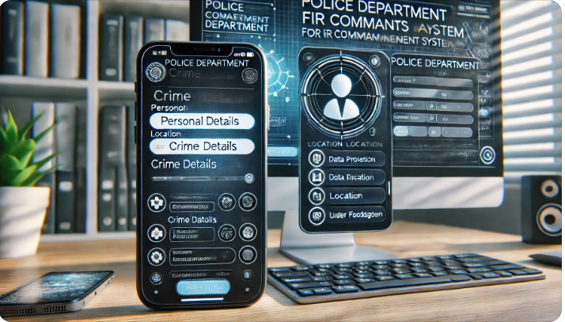
Example:
Here is the visualization of a Police Department Chatbot interface for FIR Complaints Management. It showcases a user-friendly design emphasizing accessibility, security, and guided interactions for FIR submissions.

Slide 8
Objectives
Objectives of the Project:
Develop an AI-powered chatbot to streamline FIR complaint management.
Enhance internal communication within police departments.
Improve public accessibility to law enforcement services.
Provide real-time updates and information to police officers and administrators.
Scope of the Project
Integration of Google's Dialogflow for natural language processing.
Tailored functionalities for administrators and police officers.
Secure authentication mechanisms for user access.

Slide 9
Motivation
Increased Efficiency: Automating FIR processes reduces processing times and minimizes human error, enhancing overall operational efficiency.
24/7 Accessibility: The chatbot provides round-the-clock access for the public to file FIRs and for officers to retrieve information, improving responsiveness.
Comprehensive Data Management: Real-time data processing and centralized case management streamline information handling and tracking.
Improved Internal Communication: Direct notifications and updates through the chatbot facilitate better coordination and timely information sharing within the department.

Slide 10
Motivation
Security: The system must ensure data privacy and secure access through robust authentication mechanisms.
Scalability: The chatbot should handle a growing number of users and interactions without performance degradation.
Usability: The interface must be intuitive and user-friendly to facilitate easy adoption by all user groups.
Reliability: The system should maintain high uptime and be resilient to failures, ensuring continuous availability of services.

Slide 11
Methodology
The development of the police department chatbot for FIR complaints management system followed a structured methodology to ensure the creation of a robust and efficient solution. The project commenced with a comprehensive requirements analysis, identifying the specific needs of both administrators and police officers.
Design:
The system design phase focused on architecting the chatbot using Google's Dialogflow, leveraging its natural language processing capabilities to facilitate intuitive interactions.
The chatbot interface was designed to be user-friendly, allowing seamless interaction through various platforms such as web and mobile applications.

Slide 12
Methodology
Implementation:
Implementation involved the development of backend services to handle FIR registration, status tracking, and case history retrieval.
Integration with existing police databases was achieved to enable real-time data access and updates.
Extensive testing was conducted to validate the chatbot's functionality, including user acceptance testing with a group of police officers and administrators.
Feedback from these sessions was used to refine the system, addressing any identified issues and enhancing overall performance.

Slide 13
Methodology
Deployment phase:
Finally, the deployment phase involved the integration of the chatbot into the police department's operational environment, accompanied by comprehensive training sessions for end-users.
Maintenance and support were established to ensure the system remains up-to-date and responsive to evolving needs.

Slide 14


